Slide 1
Given the examples in this text, how are potential and kinetic energy different?

Slide 2
In this lesson you will learn to answer questions about a text by citing evidence.

Slide 3
Answer
Answer
Your thinking
Your thinking
Quotes from the text
Quotes are citations

Slide 4
Below is an example of quoted text.
You can see how the exact words from the text are in quotation marks.
In the text, I read that, “There are two kinds of energy, kinetic energy and potential energy.”

Slide 5
1
Skim the text, scanning for key words.
2
Jot down your understanding.
3
Combine your thinking with quoted evidence from the text.

Slide 6
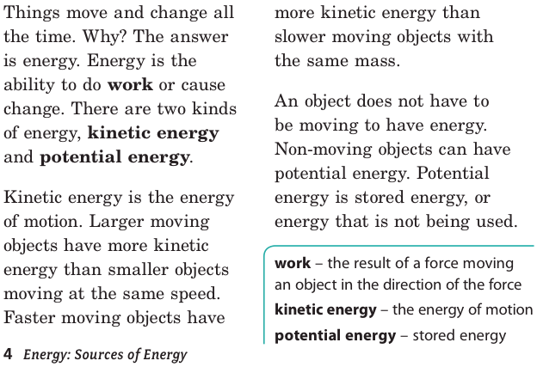
1. Skim the text, scanning for key words.

Slide 7
This example really helps me understand the difference.

Slide 8
2. Jot down your understanding.
How are these things different?
Kinetic energy is all about movement or motion.
What evidence should I quote from the text?
Potential energy is energy that hasn’t been used yet.

Slide 9
2. Jot down your understanding.
T-Charts are a great way to compare things.
Kinetic energy Potential energy
The ability to do work The ability to do work
The “energy of motion” Stored energy
Moving pole vaulter The bent pole

Slide 10
3. Combine your thinking with quoted evidence from the text.
In Chapter one, “Describing Energy,” I read that “Kinetic energy is the energy of motion,” and that, “Potential energy is stored energy, or energy that is not being used.” I also read that “a moving pole vaulter has kinetic energy. The bent pole has potential energy.” Now I understand that potential energy hasn’t been used yet, and kinetic energy is all about motion.

Slide 11
1
Skim the text, scanning for key words.
2
Jot down your understanding.
3
Combine your thinking with quoted evidence from the text.

Slide 12
In this lesson you have learned to answer questions about a text by citing evidence.

