Slide 1
ELA Debrief Winter State PLT
March 2015

Slide 2
Targets for Today:
I will understand how to create text dependent questions which require students to cite from the text to support arguments and inferences.
I will understand the components of a constructed response.
I will understand language scaffolds to help students cite tests.
I will understand how to use close reading with my students to increase reading comprehension.
Notes:
Meg

Slide 3
Tweaks to make Major Rigor Gains & Text Dependent Questions!
Key Ideas and Details
Identify the main idea of the story. Use details from the text to support your answer.
Describe the author’s message of this text. Use details from the passage to support your answer.
Craft and Structure
From what point of view is the story told? Use evidence from the text to support your thinking.
Locate the word _____ in paragraph ____. Explain how the author helps the reader to understand the meaning of this word.
Describe how the author organizes the text.
Integration of Knowledge and Ideas
What can you infer about ________? What evidence from the text supports your inference?

Slide 4
Examples and Non-Examples of Text Dependent Questions
Notes:
Meg

Slide 5
Why Constructed Response Writing?
Creates rigor
Builds higher level thinking
Component of an official ELA performance task.

Slide 6
Components of Constructed Response
Restate the Question
Analyze each part
Cite textual evidence
Explain your answer

Slide 7
Constructed Response Example
The moon is connected to the animals in the poem because it helps the animals to express themselves. The poem talks about many animals that love to be out by the light of the moon. In the poem it says that the animals that are awake and active at night are dogs, mice, cats, and bats. At night we are asleep, but these animals are awake and the moon gives them light to be able to see and live.
-4th Grade SBA Example
Restate
Analyze
Cite
Explain

Slide 8
Citing Evidence Examples
“According to the text…………….”
“I know__________________________________ because....”
“On page ______, the author stated _________________”
“The text explicitly states…………”
“I can infer _________ from _______________”
“The graphic/picture shows____________, so I know………...”
“One example from the text is……...”

Slide 9
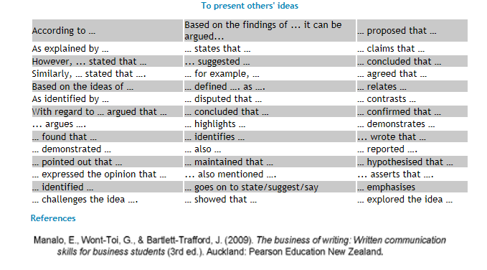

Slide 10
Add Ideas/Examples:
Also
Furthermore
Next
Moreover
In addition
Similarly
To Conclude:
In summary
In brief
Thus
In short
To sum up

Slide 11
CREATING YOUR GRADE LEVEL TOOLBOX
At your grade level table group take a moment to start creating an academic toolbox for your students. Please write by order of preference 4 – 10 words for each category. These lists will become Word Wall Posters for your classroom for next year.
What academic language words (tier 2 words) do you want every student in your grade level to know in order to:
Cite
Add Ideas/Examples
Conclude a paragraph or essay
These lists will be combined with lists from Sunset and drafts of posters will be prepared for your review before printing. I would appreciate it if Team Leaders would send me your vocabulary list by April 10th .

Slide 12
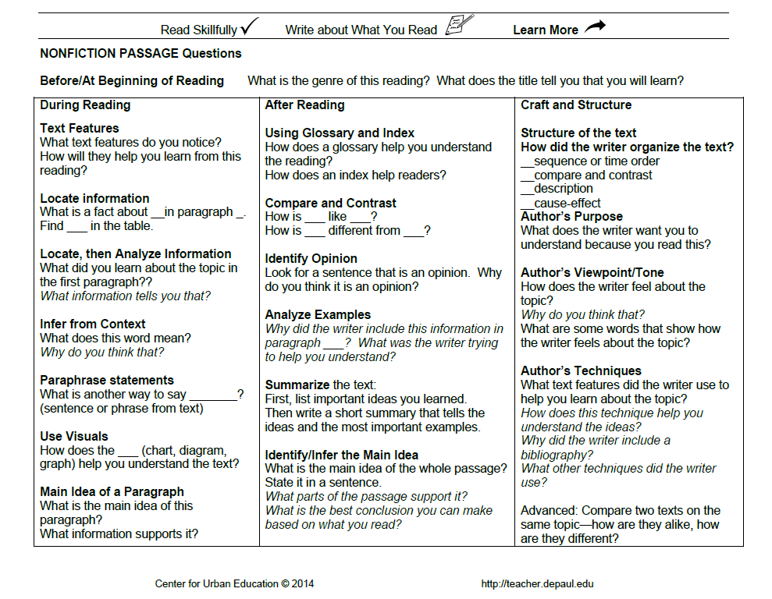

Slide 13
Closing in on Close Reading
1.Please start at page 1 and number your paragraphs through page 2
2.Please do a quick read and underline in each paragraph key ideas.
3. Circle something confusing or needs clarification.
4.Please make notes in the margin anything that stands out or connections you make.

Slide 14
Close Reading
At your table and using your “tier 2 citing words” please share with others one key point or something you made a connection with.
After everyone has shared at your table, please select a representative to share with the whole group, again remembering to use your “ tier 2 citing words.”
Resources to support all students-discuss, brainstorm, list

Slide 15
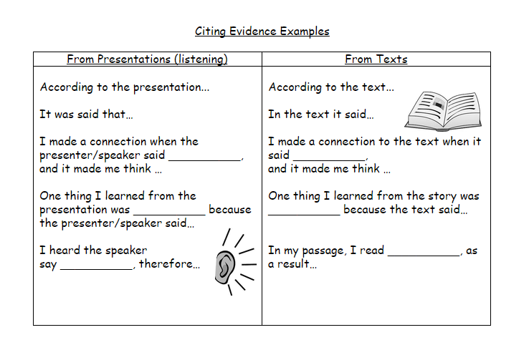

Slide 16
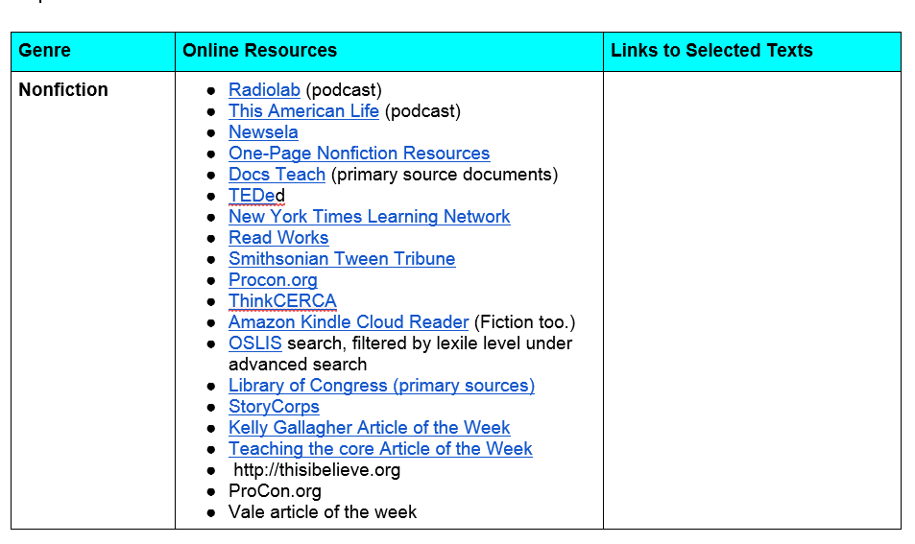

Slide 17
Vale Article of the Week
http://vms.vale.k12.or.us/articles-week
Center for Urban Learning http://teacher.depaul.edu/Reading_Passages_NONFICTION.html
Newsela https://newsela.com/

