Slide 1
Smarter Balanced
Writing to Demonstrate
English Language Arts Literacy

Slide 2
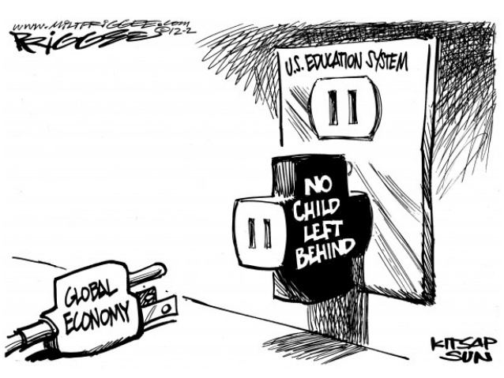
Notes:
OAKS and No Child Left Behind did not fit with what Employers want from their employees. Studies have shown that major businesses are looking for employees who possess the 4 C’s: Communication (written and oral) Collaboration, Creativity and Critical Thinking.

Slide 3
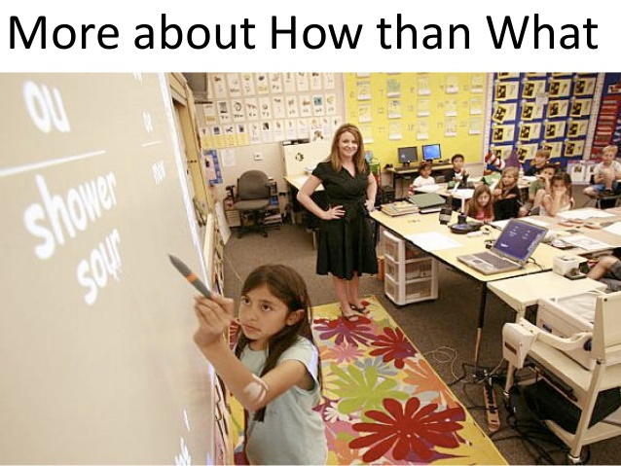
Notes:
Students need to know the process for showing their thinking and supporting their claims and not a canned multiple choice answer.

Slide 5
I Choose C
http://www.youtube.com/watch?v=dY2mRM4i6tY&feature=youtu.be
Notes:
Critical Thinking Skills, Communication Skills Needed,

Slide 6
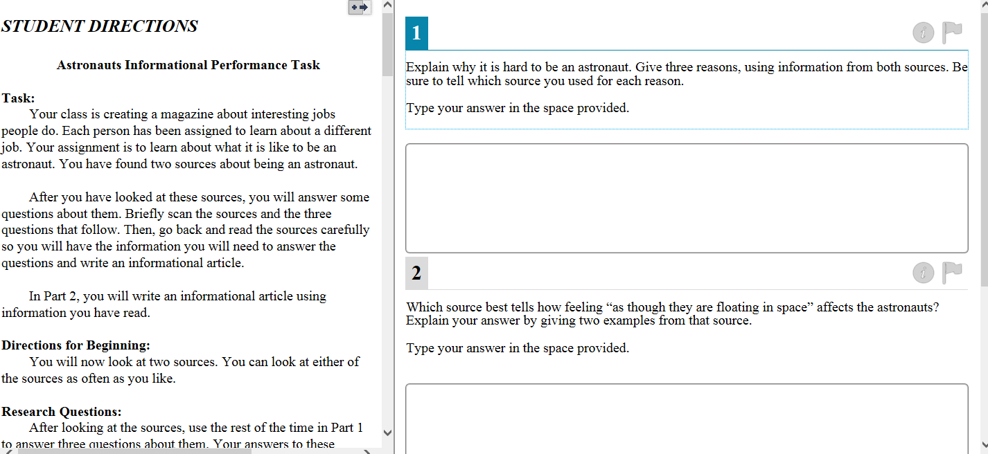

Slide 7
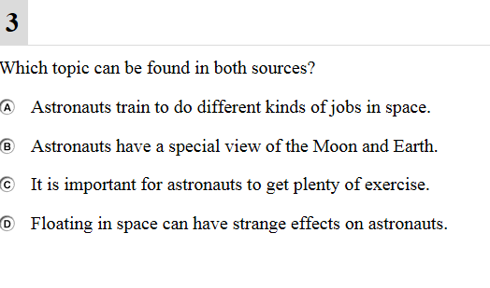

Slide 9
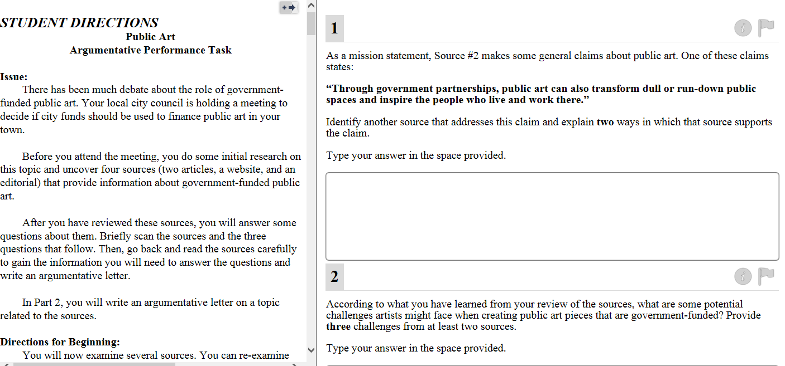

Slide 10
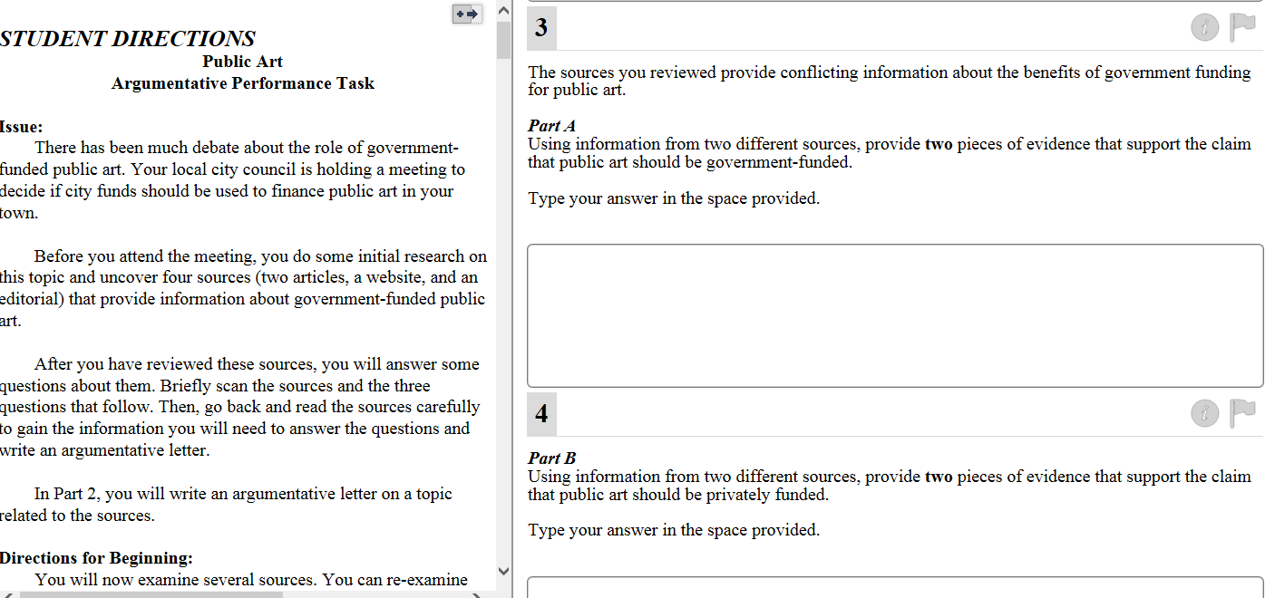

Slide 11
Common Core Trivia
Which word in the CCSS appears:
122 times?
61 times?
57 times?
Notes:
Students need to know the vocabulary of the Common Core.

Slide 12
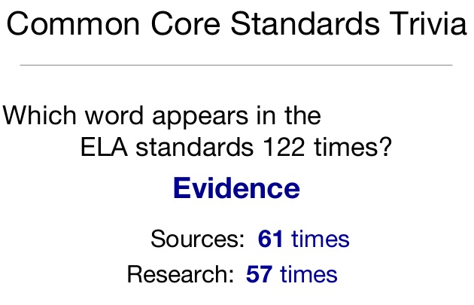

Slide 13
Assessment Vocabulary
Account for
Analyze
Argue
Assess
Comment On
Compare
Contrast
Criticize
Define
Describe
Discuss
Evaluate
Examine Summarize
Explain Trace
Illustrate
Indicate
Integrate
Interpret
Justify
Outline
Prove
Relate
Review
State
Notes:
Students need to know the Instruction Words in the Assessment Questions

Slide 14
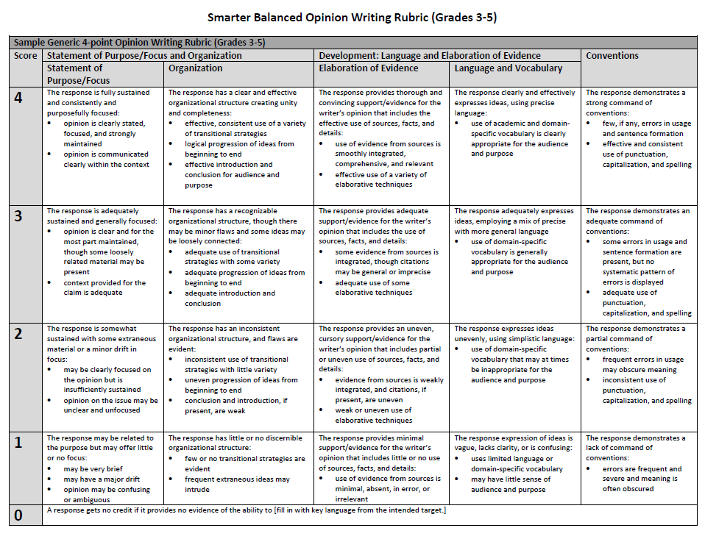

Slide 15
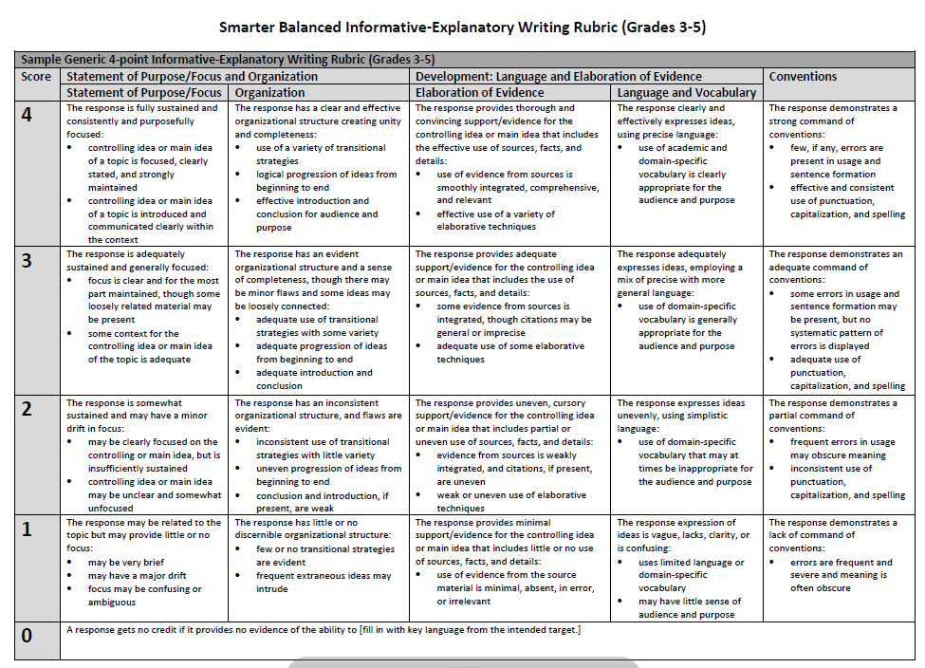

Slide 16
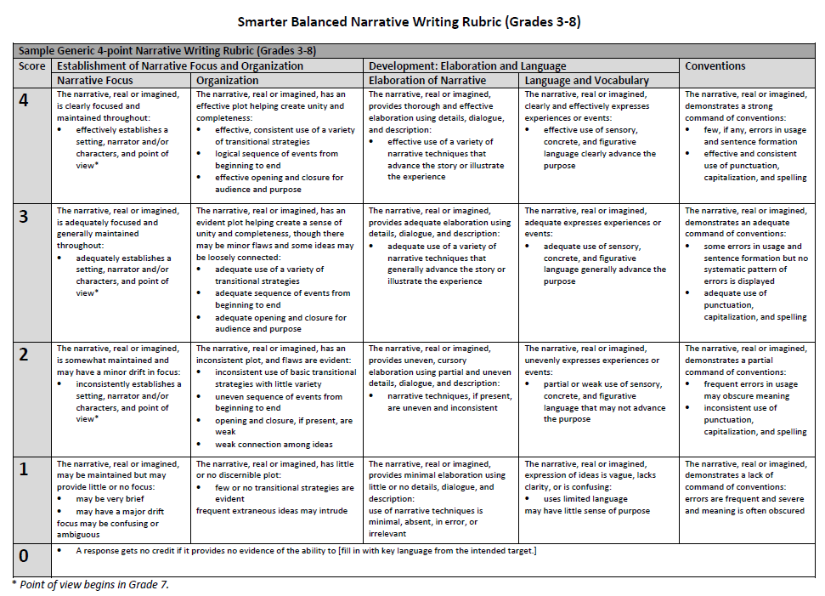

Slide 17
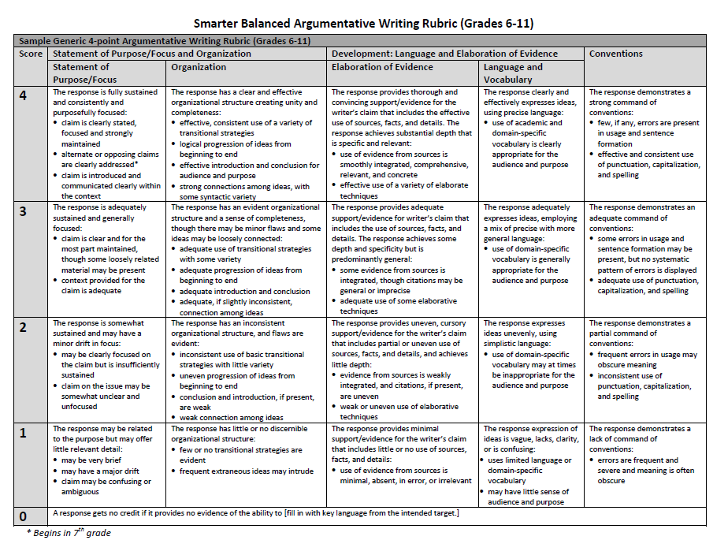

Slide 18
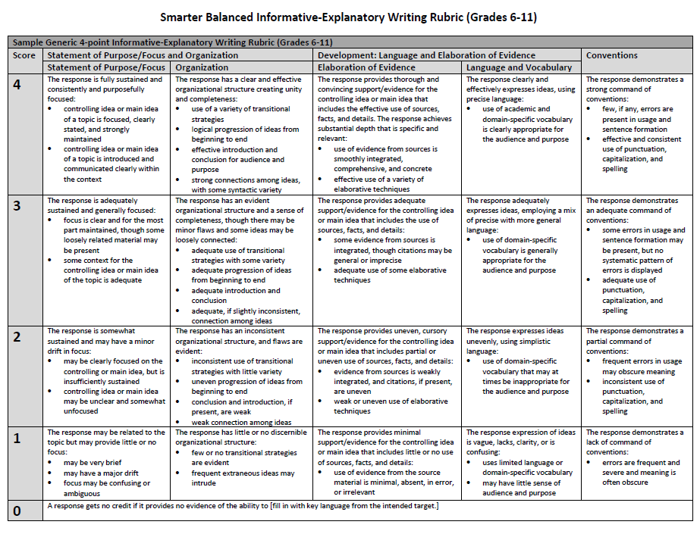
Notes:
Students need to know the rubrics by which they will be assessed in Smarter Balanced.

Slide 19
How Do We Get There?

Slide 20
Student Writing Tools
Tiered Vocabulary Lists
Sentence Frames
Paragraph Frame
Multiple Consistent Opportunities To Write Across All Content Areas Following A Similar Format

Slide 22
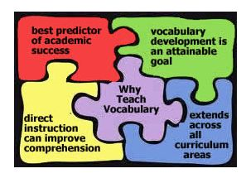

Slide 23
Sample Tier Lists
Hyde Park Central School District – New York

Slide 24
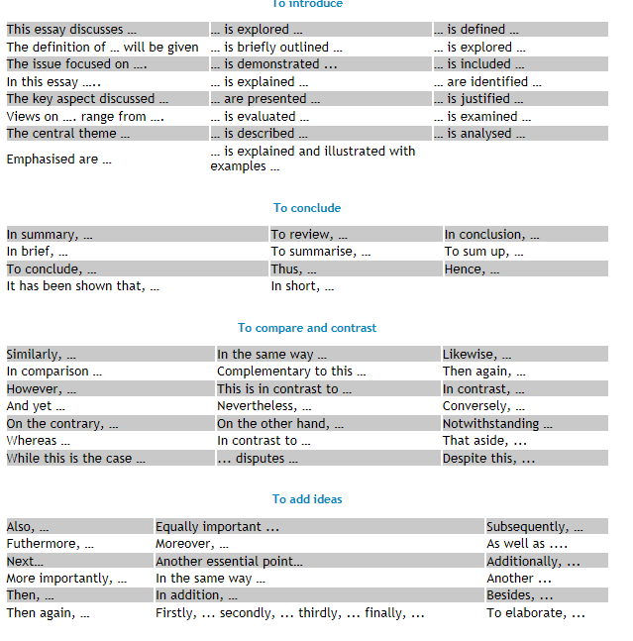

Slide 25
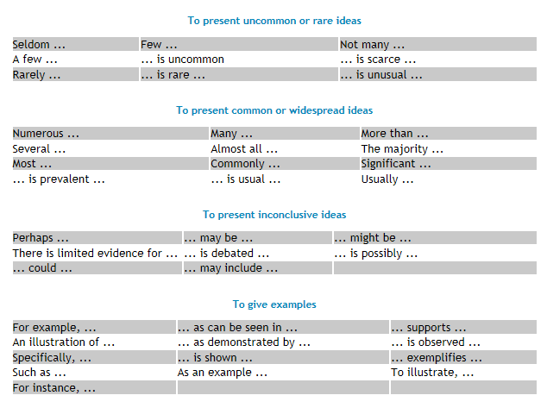

Slide 26
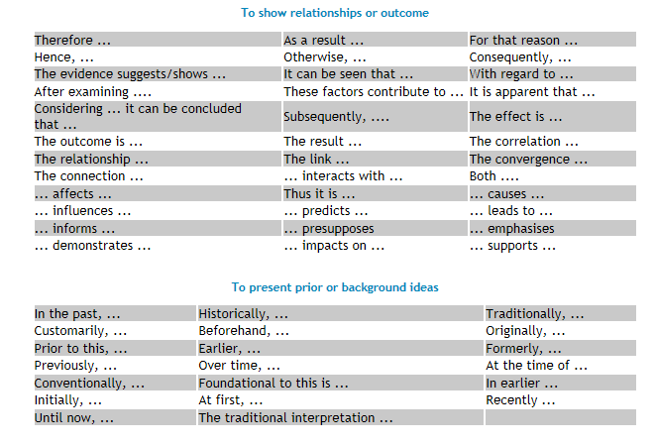

Slide 27
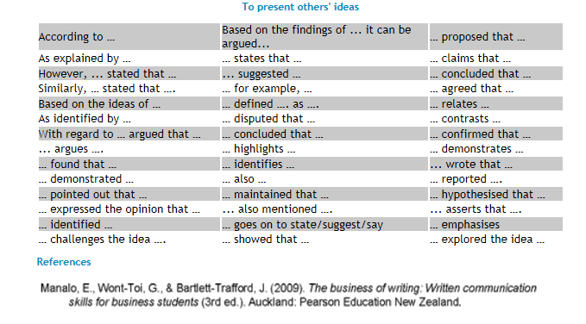

Slide 28
Smarter Balanced
Next year will be the first year that our students will be taking the Smarter Balanced Assessment.
This assessment focuses on student ability to write logical arguments with a particular focus on ideas, events, facts, and arguments presented in texts.
Students need to incorporate substantive claims, sound reasoning and relevant evidence into their writing while citing their sources.
The common cores state standards extends opinion writing, a basic from of argument, down to the earliest grades. Our students will need to be able to make evidentiary arguments in both conversation and writing.
Grade levels will need to have a plan in place for how they are going to teach and assess evidentiary writing. Agreed upon rubrics for what evidentiary writing citing sources should look like at each grade level will be essential.

Slide 29
District Wide Goal
By the end of the 2013-2014 school year, grades 2-6 will each have designed one evidentiary writing lesson with rubric and posted the lesson and rubric to the curriculum webpage.

Slide 30
What Do We Need To Have To Reach This Goal?
Mini-lessons to teach evidentiary writing
Agreed Upon Non-fiction passages
Writing prompt requiring citations
Rubric for scoring Writing

Slide 31
Lexile Range for Passages

Slide 32
Passage Lengths

